Slide 1
Tampa Alumnae Chapter
2019-2020

Slide 3
Agenda
Ritualistic Opening
Adoption of the Agenda
Review of January 2020 Chapter Meeting Minutes
Correspondence Soror Sandra Cooke
Welcome New and Visiting Sorors/Birthdays Hospitality
President’s Message Soror Alicia Warren
Executive Board Recommendations/Action items Soror Alicia Warren

Slide 4
Agenda
Budget & Finance Reports
Treasurer Soror Tiffany Mitchell
Financial Secretary Soror Briana Joseph
First Vice President’s Report Soror Brenda Webb Johnson
Second Vice President’s Report Soror Sabrina Griffith
Third Vice President’s Report Soror Angela Brown
Good of the Order Soror Sandra Cooke
Adjournment
Ritualistic Closing

Slide 5
Please use this time to state any discrepancies with the minutes for the January 2020 meeting.

Slide 6
Correspondence

Slide 7
Welcome New & Visiting Sorors and Birthday Celebrations

Slide 8
2018 – 2020 Vision
Developing Leaders
Membership Engagement
Technology Enhancements

Slide 9
President’s Message “Leading with Sisterly Love”
National/Regional/Chapter Updates
Save the Dates:
DDNC: February 23rd – 25th
Regional Conference:
May 22nd – 25th Kissimmee Fl
Registration: March 1st – April 30th

Slide 10
President’s Message “Leading with Sisterly Love”
MIT Updates
February’s mock electronic voting

Slide 11
VOTING PRESENTATION: HOW DO I VOTE USING election runner ?
TAMPA ALUMNAE CHAPTER

Slide 12
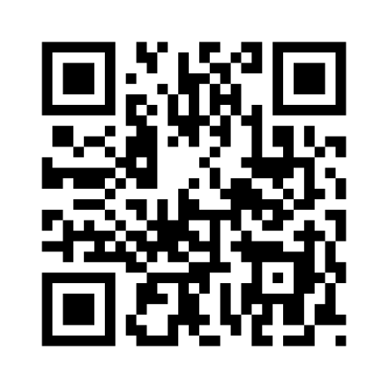
access the voting website
Access the voting website using the provided qr code.
A web browser will appear with a link displayed.
Click on the link to access the
DSTTA Membership Intake login
page.
Use the personalized login information to access the ballot.

Slide 13
LOGIN TO ELECTION RUNNER
Use the personalized login information provided at check-in to access the ballot.
login information is case sensitive.
Raise your hand if there are any issues accessing the ballot!

Slide 14
VOTING PRESENTATION: sample ballot
SAMPLE Membership Intake Ballot A
You MUST select Yes or No for EACH applicant in order for your ballot to be submitted.
Applicants may receive a maximum of 100 overall points. The maximum for each category is as follows:
20 Scholastic Achievement
15 Letter of Recommendation
15 Leadership
30 Public Service
20 Interview

Slide 15
VOTING PRESENTATION: Candidate Profiles
CANDIDATE NAME
TOTAL ASSESSMENT SCORE

Slide 16
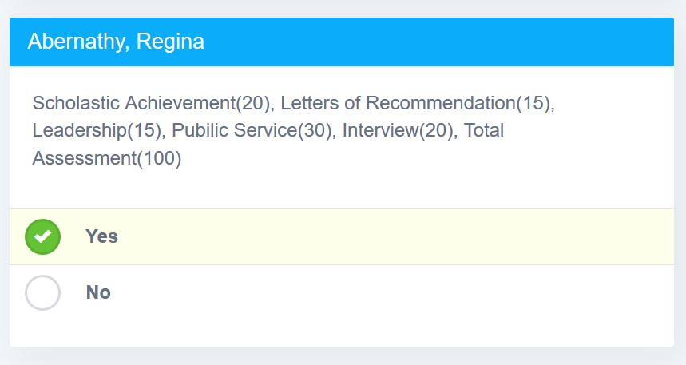
VOTING PRESENTATION: Selection Made
CHOOSE YES OR NO

Slide 17
Submit the Vote

Slide 18
OH NO! Something Went Wrong

Slide 19
Issue resolved! Re-submit the vote

Slide 20
THANK YOU FOR VOTING!

Slide 21
QUESTIONS OR CONCERNS?

Slide 22
Executive Board Recommendations/Action Items
(Bundle)
Leadership Initiative date changes:
February 20th to February 27th
April 16th to April 30th
International Awareness & Involvement date changes:
Add April 4th to the calendar for World Health Day
(Single)
Membership Services:
Add Sisterhood Month dates to chapter calendar

Slide 23
Budget & Finance

Slide 24
1st VP Report
International Awareness & Involvement: Soror Jackie Jackson, Chair
Updates
Social Action: Sorors Audrey Sullivan-Moore & Heddie Sumpter, Chairs
Census and DDAC recap
Economic Development: Soror Kay Lee Smith, Chair
Summary of Financial Fit Event
Arts & Letters: Soror Shenika Baisley, Chair
Neighborhood Red Carpet
Youth Art Exhibit: Saturday, March 7, 2020 from 10:30 am-2:00 pm Barnes & Noble Brandon, FL

Slide 25
Social Action Committee Your responses to the 2020 Census are safe, secure, and protected by federal law. Your answers can only be used to produce statistics—they cannot be used against you in any way. Your answers can help shape the future. Your online responses are safe from hacking and other cyber threats. |  | Analyzing military potential. Making business decisions. Understanding consumer needs. Planning for congregations. Locating factory sites and distribution centers. Distributing catalogs and Developing direct mail pieces. Setting a standard for creating both public and private sector surveys. Evaluating programs in different geographic areas. Providing genealogical research. Planning for school projects. Developing adult education programs. Researching historical subject areas. Determining areas eligible for housing assistance and rehabilitation loans. |  | 50 WAYS CENSUS DATA IS USED

Slide 26
Decision making at all levels of government. Drawing federal, state, and local legislative districts. Attracting new businesses to state and local areas. Distributing billions in federal funds and even more in state funds. Forecasting future transportation needs for all segments of the population. Planning for hospitals, nursing homes, clinics, and the location of other health services. Forecasting future housing needs for all segments of the population. Directing funds for services for people in poverty. Designing public safety strategies. Development of rural areas. Analyzing local trends. Estimating the number of people displaced by natural disasters. Developing assistance programs for American Indians and Alaska Natives. | 5 0 W A Y S T O U S E | Creating maps to speed emergency services to households in need of assistance. Delivering goods and services to local markets. Designing facilities for people with disabilities, the elderly, or children. Planning future government services. Planning investments and evaluating financial risk. Every household will have the option of responding online, by mail, or by phone. Publishing economic and statistical reports about the United States and its people. Facilitating scientific research. Developing “intelligent” maps for government and business. Providing proof of age, relationship, or residence certificates provided by the Census Bureau. | C E N S U S D A T A | Distributing medical research. Reapportioning seats in the House of Representatives. Planning and researching for media as backup for news stories. Providing evidence in litigation involving land use, voting rights, and equal opportunity. Drawing school district boundaries. Planning budgets for government at all levels. Spotting trends in the economic well-being of the nation. Planning for public transportation services. Planning health and educational services for people with disabilities. Establishing fair market rents and enforcing fair lending practices. Directing services to children and adults with limited English language proficiency. Planning urban land use. Planning outreach strategies. Understanding labor supply. Assessing the potential for spread of communicable diseases.

Slide 27
1st VP Report
Political Awareness & Involvement: Sorors Walinda Green-McKnight & Erica Williams, Chairs
Voter Registration Recap
Scholarship: Sorors Tina James & Joanell Lawson, Chairs
Updates

Slide 28
2nd VP Report
Nominating: Sorors DeVonne McKeever-Daniels & Alicia Howell-Banks, Chairs
Call for Nominations updates
Archives: Soror Tonja Brickhouse, Chair
Updates
Policies & Procedures: Soror Tayanna Richardson, Chair
Updates
Protocol & Traditions: Soror Marian Lauria-Gibson, Chair
Updates
Audit: Soror Gloria Williams, Chair
Audit Report

Slide 29
2nd VP Report
Collegiate Connection: Soror Jasmine White Bynum
Collegiate Social – February 1st
Sisterhood Month Activities: Soror Tekeisha Zimmerman
Church Service (location TBD) – March 1st
Community Service Event – Nursing Home Visits (organized by neighborhood captains)
Sisterhood Luncheon – March 21st (after Chapter Meeting)
Neighborhood Group Activity
Delta Connection: Sorors Theresa Cross and N’Keiba Estelle
Lunch with Dears – March 8th
Name Tags
See Soror Alicia Howell-Banks
$20

Slide 31
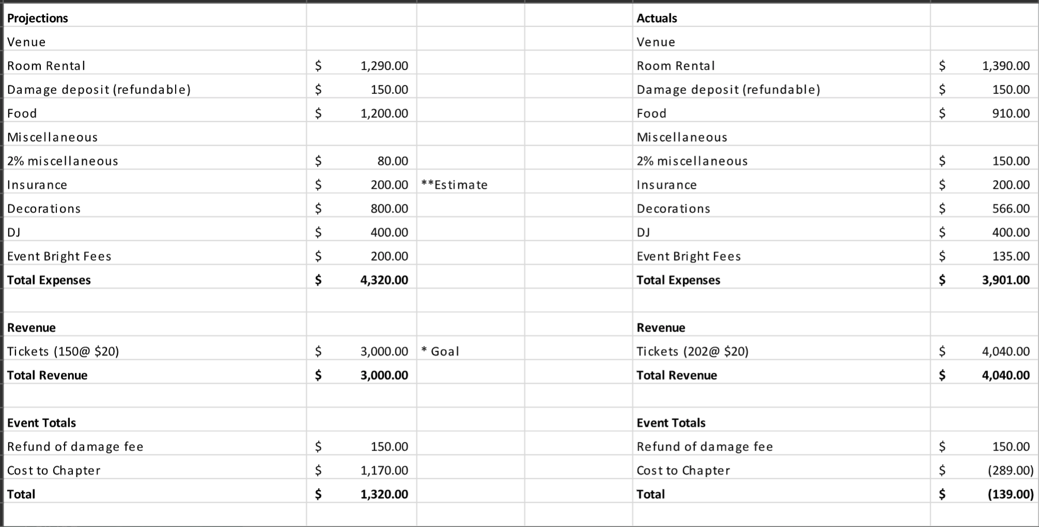
2nd VP Report
Holiday Social: Sorors Jackie Bogen & Chantelle

Slide 32
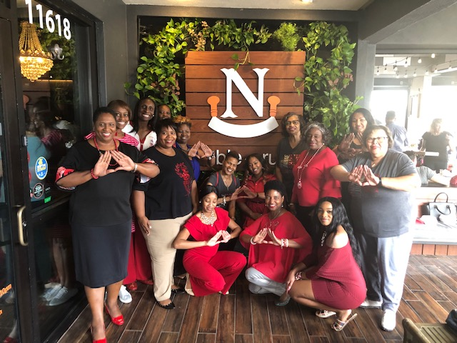
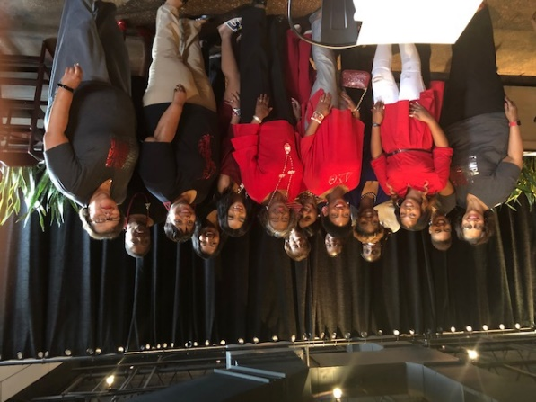
2nd VP Report
Neighborhood Groups
Purpose: Promote sisterly bonding between Sorors living in the same location
Captains:
Compassion – Soror Constance Jackson
Courtesy –
Dedication – Soror Shameika Wallen
Fellowship – Soror Shenika Baisley
Fidelity- Soror Mallory Davis
Honesty – Soror Danielle Weaver-Rogers
Justice – Soror Audrey Sullivan
Purity – Soror Rhonda Davis
Temperance – Soror Melissa Jones

Slide 33
Nominating
CALL FOR NOMINATIONS- 2020
IMPORTANT DATES TO REMEMBER
Webinar for Prospective Applicants – February 13, 2020, 8:00 p.m.
A Day In The Life of DSTTA Leadership Via Email – February 15, 2020
Application Submission Deadline – March 21, 2020, 11:59 p.m.

Slide 34
A Day In The Life of…
DSTTA Leadership

Slide 35
QUESTION 1
What previous experiences (Delta or non-Delta) helped you prepare for the position?

Slide 36
In Delta, I had served as chair and co-chair for various committees prior to being elected as a Vice President. In addition, I served as Third Vice President for two years. Outside of Delta, I have also had the pleasure to lead several committees. These experience taught me how to work with varying personalities, how to support the needs of volunteers and how to prioritize tasks of leadership.
Sabrina Griffith – 2nd Vice President

Slide 37
I was the Financial Secretary and Vice President with the Kappa Iota Chapter. I also have experience working with Excel through collegiate courses.
Brianna N Joseph – Financial Secretary

Slide 38
QUESTION 3
Which qualities or characteristics are needed to be successful in your position?

Slide 39
Patience, organization, emotional intelligence, people management experience, creativity, openness to new ideas and the ability to be humble.
Sabrina Griffith – 2nd Vice President

Slide 40
One must be open minded, unbiased, forgiving, selfless, and patient. Additionally, organization, time management, and the ability to multi-task during all meetings
Briana N Joseph – Financial Secretary

Slide 41
Archives
DSTTA Past President Profile
Name of Soror
Current Photo
Period Served as President: From: Month/Year to Month/Year
Initiation
Date of Initiation, Chapter of Initiation, City, State, Line Name
Highlights/Major Initiatives During Term as Tampa Alumnae President
(Suggested Areas but soror can use own discretion in areas to cover)
Five Point Programmatic Thrust
Fundraisers
Scholarship
Social Action
MEMBERSHIP IN DELTA SIGMA THETA
IS A LIFETIME COMMITMENT!

Slide 42
Protocol & Traditions
Traditions Reminders
Chair, Imani Coles
Co- Chair, Marian Lauria-Gibson, Ed.D.
Protocol & Traditions Committee
dsttaprotocol@gmail.com
Notes:
Remind sorors that we are doing this for all of our knowledge, NOT just because of membership intake.

Slide 43
Remember...
“3. The secret passwords, signs and grips are never written but are transmitted by word of mouth from one Delta to another. The letters of the motto should be used only in personal correspondence from one soror to another. (Note: electronic mail is public correspondence). Sorors are not to place their hand over their heart when reciting the motto. Sorors only place their hand over their heart when reciting the Delta Oath.”
Protocol and Traditions Manual 2011, page 8
Notes:
When presenting, please be sure to highlight the note about electronic mail being considered public correspondence.

Slide 44
Secret Passwords

Slide 45
Secret Signs
Notes:
Distress symbol
knock

Slide 46
Secret Grips

Slide 47
THANK YOU!
Chair, Imani Coles
Co- Chair, Marian Lauria-Gibson, Ed.D.
Protocol & Traditions Committee
dsttaprotocol@gmail.com

Slide 48
Audit
October 1 – December 31, 2019
BANK BALANCES – The bank balances represent the amount of cash available in the chapter’s various bank accounts. Records reviewed included chapter financial reports; all bank account statements, cleared check images, validated bank deposit slips, and receipt logs.
FINDINGS: The audit verified that all the bank balances are accurate; that all accounts and their balances are disclosed and reconciled monthly.
RECOMMENDATIONS: NONE

Slide 49
RECEIPTS VERIFICATION – The requirement is to review 50% of all deposits each quarter. The receipts represent the total funds collected for the reporting period including funds collected from dues, conferences, fundraising, etc. The objectives in this portion of the audit are to ensure that all funds collected are deposited within two (2) business days and that they are accurately recorded. There were 28 receipts written during this reporting period. The committee randomly sampled 14 of those receipts.
FINDINGS: It was confirmed that all receipt amounts were accurately recorded and
matched the bank statement deposits. All deposits were made in accordance with the sorority requirements of two (2) business days. However, in non-dues deposits, we had to cross reference the treasurer’s files with those of the financial secretary in order to trace the source and supporting documentation.
RECOMMENDATIONS: NONE

Slide 50
DISBURSEMENTS/EXPENDATURES VERIFICATION – The disbursements (expenditures) represent the check and non-check (wire transfers, cashier’s checks) transactions which occurred during the audit period. The requirement is to review 25% of all disbursements each quarter. The objectives of this review are to ensure all disbursements are recorded timely, properly supported/approved, and accurately recorded. Validation included a review of bank statements, chapter financial reports, checkbook stubs, cancelled check images, chapter minutes, disbursement vouchers and supporting documentations. There were 103 disbursements during this period. The committee reviewed 25% or 28 of the disbursements, including 10% of the non-check disbursements.
FINDINGS: All of the disbursements included valid supportive documentation including vouchers with invoices. Disbursements were recorded in a timely manner. The separation of duties was observed. Documentation exists to support 10% of the non-check disbursements in the sample selected.
RECOMMENDATIONS: NONE

Slide 51
BUDGET
FINDINGS:
The chapter does have an approved budget. The budget is adhered to during the year. Revisions are properly approved and documented.
RECOMMENDATIONS: NONE

Slide 52
DUES VERIFICATION – The objective of the dues verification is to validate that 100% of all members’ dues are submitted to National Headquarters within thirty (30) days of receipt, credited to the correct soror, and were recorded for the correct fiscal period. Validation included a review of: receipts log of dues collected during this audit period; copies of transmittals submitted to National Headquarters during this audit period; and evidence that transmittals were closed. The committee reviewed 100% of all dues collected during the audit period. Dues for 22 sorors were examined, including two who transferred from other alumnae chapters.
FINDINGS: All collected dues were sent to National Headquarters within the required
30-day time period.
RECOMMENDATIONS: NONE

Slide 53
OVERALL AUDIT FINDINGS
After review by the Chapter Internal Audit Committee, it has been determined that the chapter does have satisfactory financial internal controls and the review supports the existence and utilization of these controls.
PROPOSED NEXT QUARTER AUDIT SCHEDULE
Receive financial documents no later that the first chapter meeting after the quarter ends
Audit performed shortly thereafter during April 2020
Report back to chapter at the May chapter meeting

Slide 54
3rd VP Report
Queen Of Hearts: Sorors Paulette Walker & Joyce Patterson, Chairs
March 28, 2020
Centro Asturiano de Tampa 6:00 pm-11:00 pm
Event is SOLD OUT
Donation opportunities
Table selection details
NPHC: Soror Jasmine White Bynum
Greek Workout: Saturday, February 22
9:00 a.m. @ Roy Haynes Park -1902 S. Village Ave.
Coming Soon
Club Delta
2020 – 2021 Fundraising Planning meting

Slide 55
3rd VP Report
Fundraising Minute: Logo Contest
Upcoming Events: Updates
We Vote t-shirts
Chapter t-shirts

Slide 56
Good of the Order

Slide 57
Adjournment

Slide 58
Ritualistic Closing

