Slide 1

Tampa Alumnae Chapter
2019-2020

Slide 2
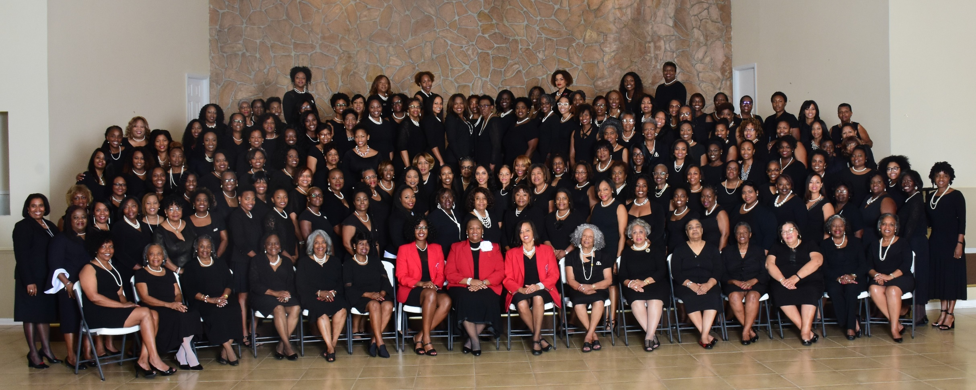

Slide 3
Agenda
Meditation Chaplain Team
Adoption of the Agenda
Review of June 2019 Executive Board Minutes
Correspondence Soror Sandra Cooke
President’s Message: Soror Alicia Warren

Slide 4
Agenda
Budget & Finance Reports
  Treasurer Soror Tiffany Mitchell
  Action Item:
  - Ad for Pace Luncheon
  - Donation to Middleton HS
  Financial Secretary Soror Briana Joseph
Membership Intake Presentation Soror Marian Lauria-Gibson
Soror Brenna Fields Taylor
First Vice President’s Report Soror Brenda Webb Johnson
Second Vice President’s Report Soror Sabrina Griffith
Third Vice President’s Report Soror Angela Brown
Good of the Order Soror Sandra Cooke
Adjournment

Slide 5
President’s Message
“Leading with Sisterly Love”
National/Regional/Chapter Updates
  National Convention – Cancelled due to Tropical Storm Barry
  Save the Dates:
    Cluster: Miami Fl November 8th – 10th
    Bay Area Founders Day: Hosted by Lakeland Alumnae - January 25th
    DDNC: February 9th – 11th
    DDAC: February 23rd – 25th
    Regional Convention: Date/TBD Location/Kissimmee Fl
Action Items:
  Move November E-board meeting to the 4th
  Move November Chapter meeting back to the 16th

Slide 6
President’s Message
“Leading with Sisterly Love”
Kudos to:
We are in COMPLIANCE!: Thanks to Soror Tiffany Mitchell (Treasurer) & Soror Gloria Williams (Audit Chair)
Bahamas Round-up Donations: Thanks to Membership Services, International Awareness & Involvement, and PR collaboration! (Soror Estella Gray, Soror Jackie Jackson, & Soror Jamel Lanee)
Hot Topic(s):
Leadership Initiative update: Soror Tayanna Richarson

