Slide 1
Public Relations Committee 2019

Slide 2
Role
Build positive relationships with stakeholders, media, and the public
Develop PR Strategies for the chapter
Cultivate a positive Chapter Image

Slide 3
Responsibilities
Press Releases
Media Contact (TV, RADIO, NEWS)
Newsletter
Social Medial Posts
Event Marketing
Flyers

Slide 4
Flyer Vendors
Nicole Miller-Rocque
Executive Administrator
www.creativeimpressionz.com
813.239.7060
Selim Nurudeen
Graphic Designer
Selim.nurudeen@gmail.com
Carly Marie Jackson
Creative Designer
Carlymarie.07@gmail.com
Acid Flyers
AcidFlyers.com
Discount Code: Acid20

Slide 5
Flyer
Digital Flyer
Printed Flyer
10% Flyer
Teaser Flyer
“Pubbing”

Slide 6
Approval Process
Committee
PR
Assigned VP
Chapter President

Slide 7
Social Media Posts
Instagram, Facebook, and Twitter
Please submitted Social Media Posts/Requests/pictures to DSTTAPR@gmaIL.com
PR will send out Posting Materials

Slide 8
NEW Look
High-Quality Images
Photo-Consistency
Set a Color Scheme/Palette
Keep Things Simple
125 characters per post
Example A
Example B
Example C
Example D
Current Instagram

Slide 9
News Coverage
Appropriate Events
Live Coverage
Interviews
Press Release
Send videos to dropbox

Slide 10
PR Procedure
6-8 Weeks – PR Request Form
4-5 Weeks – Press Release submitted to Media
4-5 Weeks – Submit Flyer to PR for Approval
3-4 weeks – Approved Flyer and Social Media Materials will be sent/posted
2 Weeks – Press Release Submitted to Media
1 Week – physical Pubbing, if needed
1 day – Press Release Submitted to Media

Slide 11
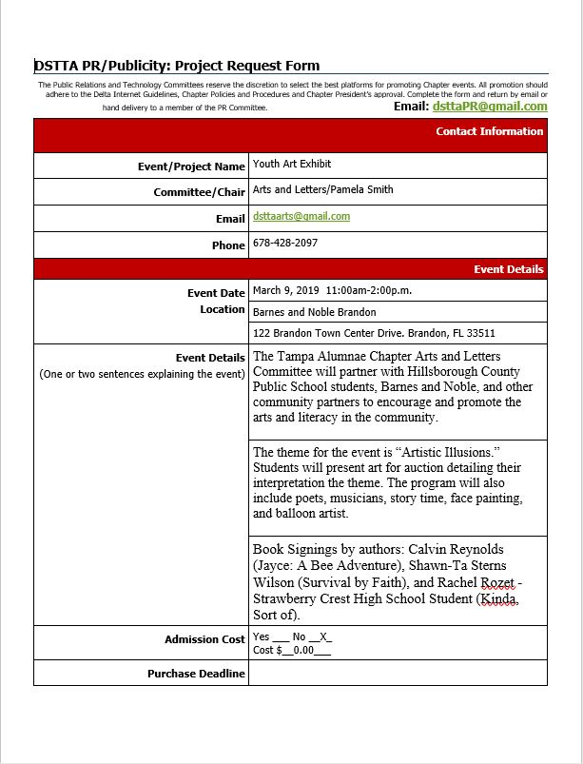
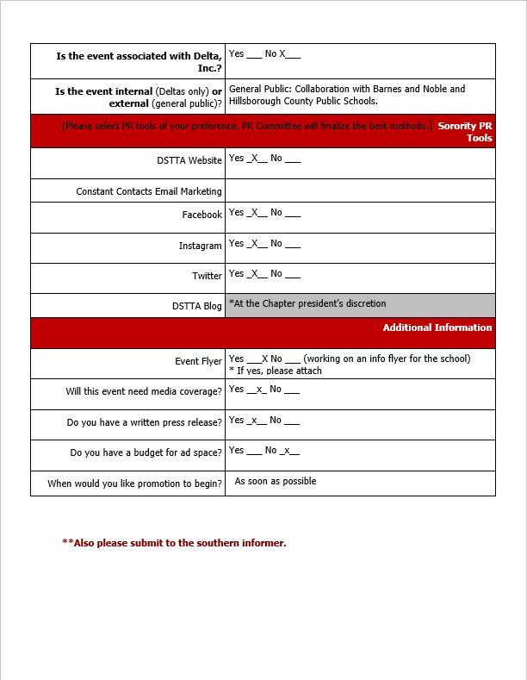
Pr Request Form

Slide 12
LOGO
It should be audience-appropriate.
It should be easy to read.
It should be distinct.
It should be scalable.

Slide 13
Future Logo Designs

Slide 14
Email
dsttapr@gmail.com

