Slide 1
Tampa Alumnae Chapter
2019-2020

Slide 3
Agenda
Meditation Chaplain Team
Adoption of the Agenda
Review of January 2020 Executive Board Minutes
Correspondence Soror Sandra Cooke
President’s Message Soror Alicia Warren

Slide 4
Agenda
Budget & Finance Reports
Treasurer Soror Tiffany Mitchell
Financial Secretary Soror Briana Joseph
First Vice President’s Report Soror Brenda Webb Johnson
Second Vice President’s Report Soror Sabrina Griffith
Third Vice President’s Report Soror Angela Brown
Good of the Order Soror Sandra Cooke
Adjournment

Slide 5
President’s Message “Leading with Sisterly Love”
National/Regional/Chapter Updates
Save the Dates:
DDAC: February 9th – 11th
DDNC: February 23rd – 25th
Regional Conference:
May 22nd – 25th Kissimmee Fl
Registration: March 1st – April 30th

Slide 6
President’s Message “Leading with Sisterly Love”
Preparing for electronic voting – Soror Angela Brown
MIT Updates – Soror Dioan Johnson
Leadership Initiative: Date changes – Soror Tayanna Richardson

Slide 7
1st VP Report
International Awareness & Involvement: Soror Jackie Jackson, Chair
Updates & 1 action item
Social Action: Sorors Audrey Sullivan-Moore & Heddie Sumpter, Chairs
Census and DDAC recap
Economic Development: Soror Kay Lee Smith, Chair
Summary of Financial Fit Event
Arts & Letters: Soror Shenika Baisley, Chair
Neighborhood Red Carpet
Youth Art Exhibit: Saturday, March 7, 2020 from 10:30 am-2:00 pm Barnes & Noble Brandon, FL

Slide 8
1st VP Report
Political Awareness & Involvement: Sorors Walinda Green-McKnight & Erica Williams, Chairs
Voter Registration Recap
Scholarship: Sorors Tina James & Joanell Lawson, Chairs
Updates

Slide 9
2nd VP Report
Nominating: Sorors DeVonne McKeever-Daniels & Alicia Howell-Banks, Chairs
Call for Nominations updates
Archives: Soror Tonja Brickhouse, Chair
Updates
Policies & Procedures: Soror Tayanna Richardson, Chair
Updates
Protocol & Traditions: Soror Marian Lauria-Gibson, Chair
Updates
Audit: Soror Gloria Williams, Chair
Audit Report

Slide 10
3rd VP Report
Queen Of Hearts: Sorors Paulette Walker & Joyce Patterson, Chairs
March 28, 2020
Centro Asturiano de Tampa 6:00 pm-11:00 pm
Event is SOLD OUT
Donation opportunities
Table selection details
NPHC: Soror Jasmine White Bynum
Greek Workout: Saturday, February 22
9:00 a.m. @ Roy Haynes Park -1902 S. Village Ave.
Fundraising Minute:
We Vote t-shirts
Chapter t-shirts
Coming Soon
Club Delta
2020 – 2021 Fundraising Planning meting

Slide 11
Appendix
Financial Fitness Flyer
Queen of Hearts Presentation

Slide 13
2020 Queen of Hearts Scholarship and Community Service Gala
“DELTA GOES TO WAKANDA”

Slide 14
Saturday, March 28, 2020
6:00 P.M. – 11:00 P.M.
Centro Asturiano de Tampa
1913 North Nebraska Avenue
Tampa, FL 33602
Tickets - $100 per person
8 seats per table
Attire – African Elegant

Slide 15
TICKET REQUIRED
Everyone – Chapter President, Chapter Officers, Committee Co-Chairs, Committee Members, Hostesses, Sorors, Family Member(s), Friends, Guests – will need a ticket in order to enter the venue.

Slide 16
ADDITIONAL TICKET INFORMATION
If a soror sells a ticket to another soror at a price different from the chapter’s agreed upon price, said transaction will be considered as a transaction between two sorors with no Code of Conduct violation. However, if a soror sells a ticket to a non-Soror at a price different from the chapter’s agreed upon price, said transaction will be considered as a 1-G Code of Conduct violation which is failure to comply with any policies, procedures, rules or regulations of the Sorority

Slide 17
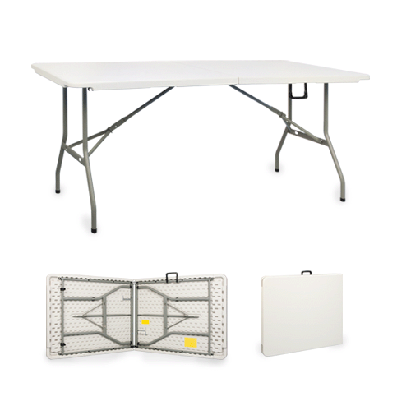
SET UP CONFIGURATION
In order to accommodate the 350 person capacity AND have an ample dance floor, there will be both round tables and rectangular tables.
Round tables will seat 8 and rectangular tables will seat 10.

Slide 18
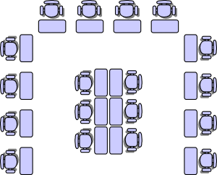
TABLE/SEAT SELECTION DATE
Tuesday, March 10, 2020
Young Middle Magnet School
Exact time periods to be decided
Table set up diagram will be available

Slide 19
TABLE/SEAT SELECTION PROCESS
Sorors WILL NOT be able to combine number of tickets sold in order to select a table.
Complete tables will be sold first.
The table selection process shall proceed as follows: First and second selections by the current chapter President and committee chairs (full tables only). All subsequent selections shall be made by all remaining sorors including officers and committee members (as per page 33 – Chapter’s Policies and Procedures - Event Seating Criteria).

Slide 20
TABLE/SEAT SELECTION PROCESS cont’d.
If a soror who purchased a ticket(s) decides to exchange or sell her ticket(s), said soror must provide Soror Paulette Walker with the exchangee’s/purchaser’s name (via email message – pwalker25p@yahoo.com), no later than Friday, March 6 at midnight in order to eliminate an embarrassing situation on Tuesday, March 10 during the table/seat selection process.

Slide 21
TABLE/SEAT SELECTION PROCESS cont’d.
If a soror who purchased a ticket(s) is unable to attend/participate in the March 10, 2020 table/seat selection process, said soror must provide Soror Paulette Walker (via email message – pwalker25p@yahoo.com), no later than Friday, March 6 at midnight with the name of the soror who will select said soror’s table/seat. Failure to do so, will result in the Committee selecting the said soror’s table/seat during the time period said soror was designated to select table/seat.

Slide 22
DONATIONS/ADS PACKAGE
If you request a donations package please see Soror Shantel Bobo or Soror Janet Solly.
If you request an ads package please see Soror Areatha Morrow.

Slide 23
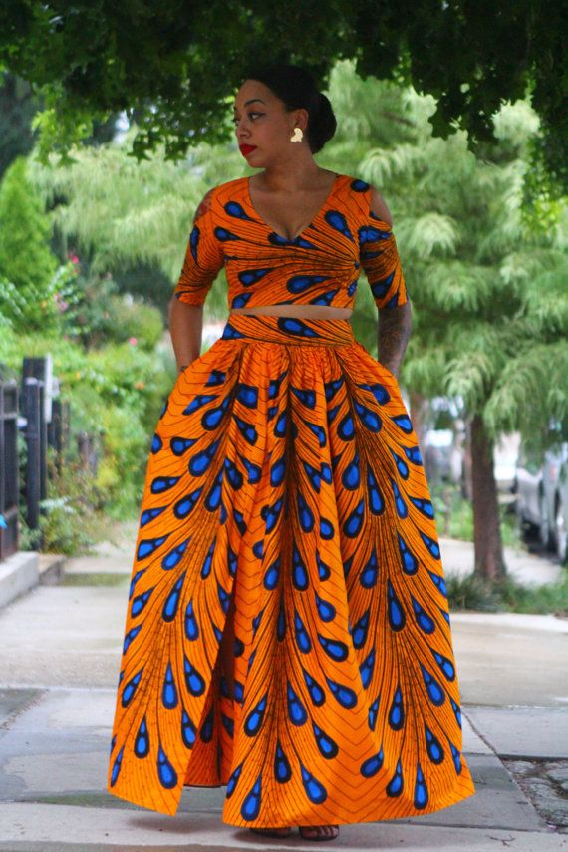
HOSTESSES
If you want to serve as a hostess on the night of the event please see Soror Marian Lauria-Gibson and remember you must have a ticket.

Slide 24
We thank you in advance for YOUR support and YOUR participation!!!

