Slide 1
Tampa Alumnae Chapter
2019-2020

Slide 3
Agenda
Ritualistic Opening
Adoption of the Agenda
Review of November 2019 Chapter Meeting Minutes
Correspondence Soror Christine Lewis
Welcome New and Visiting Sorors/Birthdays Hospitality
President’s Message Soror Alicia Warren
Executive Board Recommendations/Action items Soror Alicia Warren
MIT Calendar & Budget Soror Leslie Brown

Slide 4
Agenda
Budget & Finance Reports
Treasurer Soror Tiffany Mitchell
Financial Secretary Soror Briana Joseph
Mock Electronic Voting (Training) Election Committee
Technology Committee
Membership Services/Delta Connection
First Vice President’s Report Soror Brenda Webb Johnson
Second Vice President’s Report Soror Sabrina Griffith
Third Vice President’s Report Soror Angela Brown
Good of the Order Soror Christine Lewis
Adjournment
Ritualistic Closing

Slide 5
Please use this time to state any discrepancies with the minutes for the November 2019 meeting.

Slide 6
Correspondence

Slide 7
Welcome New & Visiting Sorors and Birthday Celebrations

Slide 8
2018 – 2020 Vision
Developing Leaders
Membership Engagement
Technology Enhancements

Slide 9
President’s Message “Leading with Sisterly Love”
National/Regional/Chapter Updates:
Save the Dates:
Bay Area Founders Day: Hosted by Lakeland Alumnae - January 25th
DDAC: February 9th – 11th
DDNC: February 23rd – 25th
Regional Conference: Date/TBD Location/Kissimmee Fl

Slide 10
President’s Message “Leading with Sisterly Love”
First half of the sororal year completed activities/events:
Leadership planning meeting with Executive Board chairs/co-chairs
Membership Services: Delta “En Blanc” 2019 Round-Up
IA&I: Hurricane Relief Efforts for our Sister Chapters in the Bahamas
Back-to-School-Bash at Raymond James Stadium (Individual volunteer activity)
Delta Academy, GEMS, & EMBODI: Volunteering at Metropolitan Ministries
Delta Academy: College & Career Expo
Delta GEMS: Team building activity at USF (low ropes course)
EMBODI: Hosted Attorney Ed Narain
PAI Voter’s Registration
PAI & SA are collaborating with NPHC Tampa Chapter (2020 Census & Voter Registration)
Leadership Initiative program
Participated in “Making Strides Breast Cancer” walk
PMH “Walk It Out” neighborhood activity
Reds & Whites
Arts & Letters: Book Club and Red Carpet Events(Harriet & 21 Bridges**Membership Services)
Holiday Wine Down with Tina Lifford (Individual volunteer activity)
Christmas Social

Slide 11
Executive Board Recommendations/Action Items
(Single)
MIT Calendar & Budget

Slide 12
Budget & Finance

Slide 13
1st VP Report
Arts & Letters: Soror Shanika Baisley, Chair
Recap Red Carpet Event #2 – “21 Bridges”
Wine Down with Tina Lifford
Book Club updates

Slide 14
2nd VP Report
Member Services: Soror TeKeisha Zimmerman, Chair
Holiday Party Updates
Delta Connection: Sorors Theresa Cross & N’Keiba Estelle, Chairs
Delta Dear updates
Hospitality: Soror Alicia Howell-Banks, Chair
Updates
Collegiate Connection: Soror Jasmine White-Bynum, Chair
Presentation
Public Relations: Sorors Mallory Davis & Jamel Lanee, Chairs
Updates

Slide 15
Collegiate Connection
Intentionally Building Relationships with Transitioning Sorors
Chair: Jasmine White-Bynum

Slide 16
Collegiate Connection Goals
Ensure positive transition from Collegiate to Alumnae Chapters
Help Sorors build relationships and remain active post-transition

Slide 17
Tampa Alumnae Strategy
First Meeting
Provide TA Welcome Packet
Sign up for next TA 101 session
First Month
Add to Neighborhood Group Distro
Q&A Call with Membership Services Chair
Within 3 Months
Assist with Committee Sign-Up
Connect with three Sorors in the Chapter

Slide 18
Additional Activities
Annual Collegiate Social/Meet –n- Greet
Hosted in April
Open to all Sorors
Collegiate version of TA 101
Held in February each year
Attend collegiate meeting for introductions and share details/answer questions about TA and Alumnae transition
Financial Support
Provide discount for first year local dues to new collegiate Sorors

Slide 19
Questions?

Slide 20
Public Relations Committee 2019

Slide 21
Role
Build positive relationships with stakeholders, media, and the public
Develop PR Strategies for the chapter
Cultivate a positive Chapter Image

Slide 22
Responsibilities
Press Releases
Media Contact (TV, RADIO, NEWS)
Newsletter
Social Medial Posts
Event Marketing
Flyers

Slide 23
Flyer Vendors
Nicole Miller-Rocque
Executive Administrator
www.creativeimpressionz.com
813.239.7060
Selim Nurudeen
Graphic Designer
Selim.nurudeen@gmail.com
Carly Marie Jackson
Creative Designer
Carlymarie.07@gmail.com
Acid Flyers
AcidFlyers.com
Discount Code: Acid20

Slide 24
Flyer
Digital Flyer
Printed Flyer
10% Flyer
Teaser Flyer
“Pubbing”

Slide 25
Approval Process
Committee
PR
Assigned VP
Chapter President

Slide 26
Social Media Posts
Instagram, Facebook, and Twitter
Please submitted Social Media Posts/Requests/pictures to DSTTAPR@gmaIL.com
PR will send out Posting Materials

Slide 27
NEW Look
High-Quality Images
Photo-Consistency
Set a Color Scheme/Palette
Keep Things Simple
125 characters per post
Example A
Example B
Example C
Example D
Current Instagram

Slide 28
News Coverage
Appropriate Events
Live Coverage
Interviews
Press Release
Send videos to dropbox

Slide 29
PR Procedure
6-8 Weeks – PR Request Form
4-5 Weeks – Press Release submitted to Media
4-5 Weeks – Submit Flyer to PR for Approval
3-4 weeks – Approved Flyer and Social Media Materials will be sent/posted
2 Weeks – Press Release Submitted to Media
1 Week – physical Pubbing, if needed
1 day – Press Release Submitted to Media

Slide 30
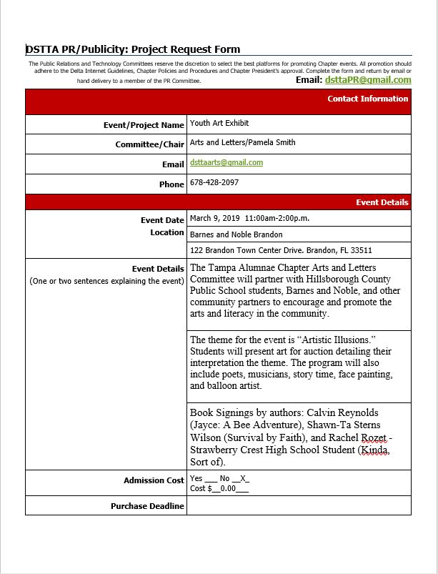
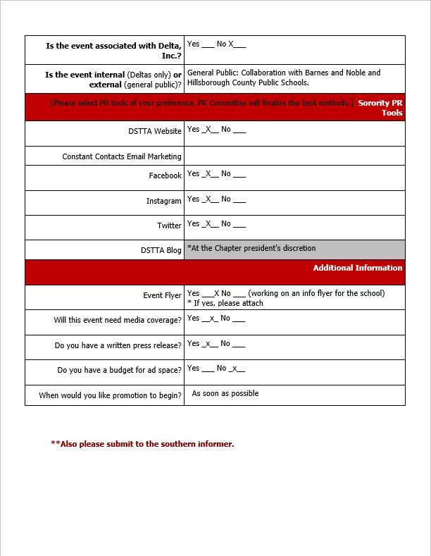
Pr Request Form

Slide 31
LOGO
It should be audience-appropriate.
It should be easy to read.
It should be distinct.
It should be scalable.

Slide 32
Future Logo Designs

Slide 33
Email
dsttapr@gmail.com

Slide 34
3rd VP Report
Reds and Whites: Sorors Jasmine White Bynum & Stephanie Love, Chairs
Event Recap & Review of Final Budget
Queen Of Hearts: Sorors Paulette Walker & Joyce Patterson, Chairs
March 28, 2020
Centro Asturiano de Tampa 6:00 pm-11:00 pm
Tickets are SOLD OUT
Sponsorship packets and Digital Ads
Table Selection
Fundraising Minute: Logo Contest
Upcoming Events: What is a Logo??
We Vote t-shirts
Chapter t-shirts
Cycle fundraising event

Slide 35
Reds & Whites Final Budget |  | Proposed |  | Actual
Income
GA tickets | 300@25 | $ 7,500 | 334@25 | $ 8,350
VIP tickets | 40@40 | $ 1,600 | 51@40 | $ 2,040
Painting Raffle $ |  | $ - |  | $ 167
Donations |  | $ - |  | $ 175
In Kind Donations catering, decor, Vegas trip, dessert |  |  |  |  | $ 1,603
Total Income |  | $ 9,100 |  | $ 10,732
Proposed Expenses
Venue |  | $ 700 |  | $ 1,050
DJ |  | $ 300 |  | $ 400
Insurance Rider |  | $ 200 |  | $ 200
Tickets/Flyers |  | $ 150 |  | $ 102
Catering |  | $ 1,895 |  | $ 2,783
VIP Items |  | $ 200 |  | $ 460
Decorations |  | $ 300 |  | $ 329
Total Expenses | $ - | $ 3,745 | $ - | $ 5,323
 |  | $ (375) |  | $ -
Total Net Profit |  | $ 4,980 |  | $ 5,409

Slide 36
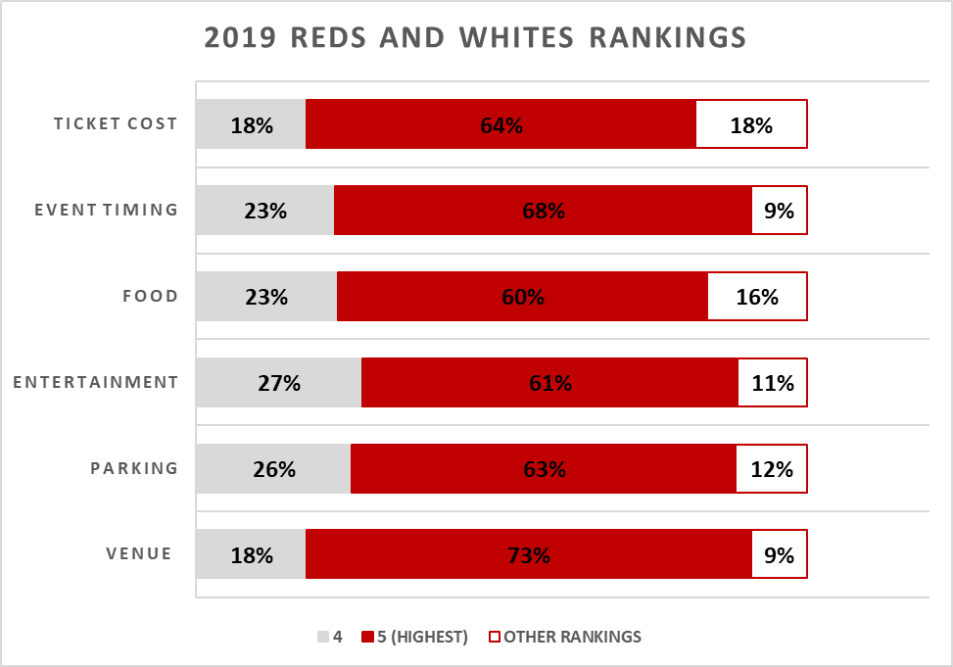
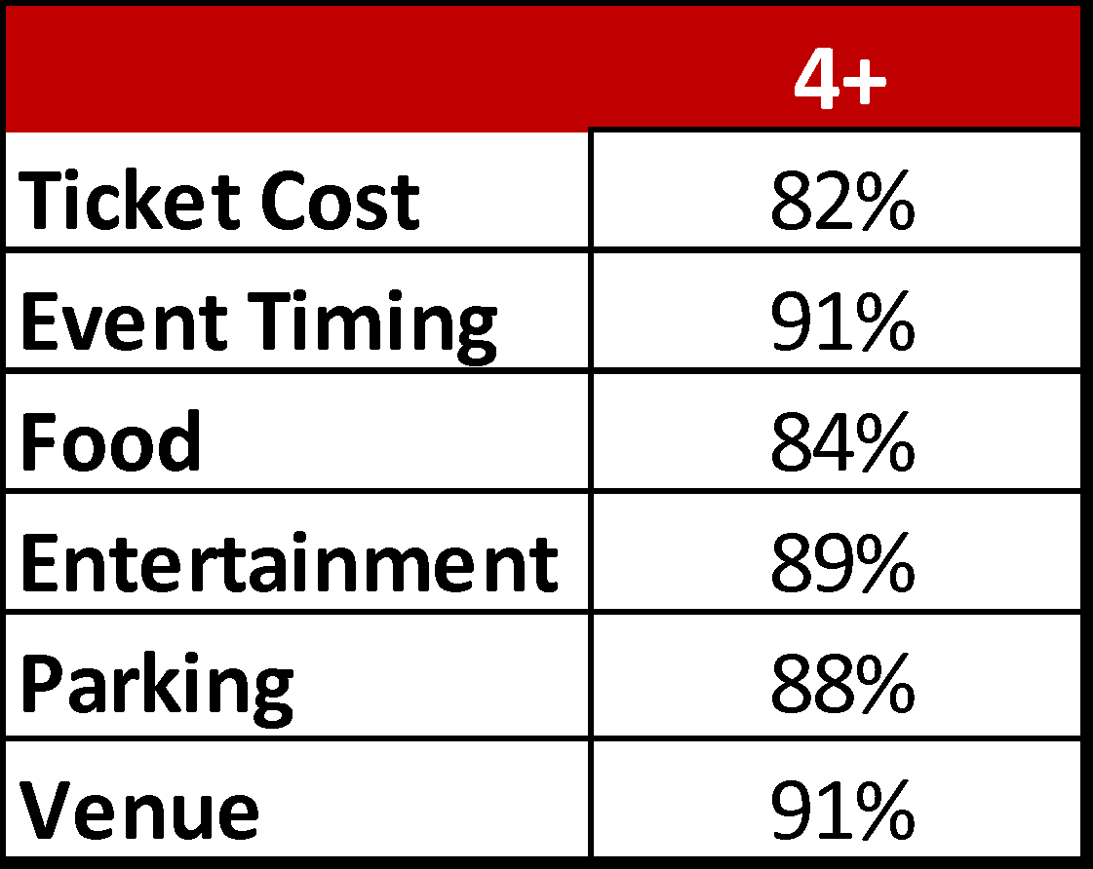
Survey Results
Pros:
“Outstanding event... including the Art element was an excellent choice.”
“Wonderfully presented. I especially enjoyed the VIP session.”
“The hostess had on great outfits and the event was very organized.”
“The BEST wine tasting we've had since it started!”
Areas for improvement:
Issues with locating the venue
Additional seating
More announcements for raffle tickets
Acoustics – better mic

Slide 37
Good of the Order

Slide 38
Adjournment

Slide 39
Ritualistic Closing

