Slide 1
2020 Queen of Hearts Scholarship and Community Service Gala
“DELTA GOES TO WAKANDA”

Slide 2
Saturday, March 28, 2020
6:00 P.M. – 11:00 P.M.
Centro Asturiano de Tampa
1913 North Nebraska Avenue
Tampa, FL 33602
Tickets - $100 per person
8 seats per table
Attire – African Elegant

Slide 3
TICKET REQUIRED
Everyone – Chapter President, Chapter Officers, Committee Co-Chairs, Committee Members, Hostesses, Sorors, Family Member(s), Friends, Guests – will need a ticket in order to enter the venue.

Slide 4
ADDITIONAL TICKET INFORMATION
If a soror sells a ticket to another soror at a price different from the chapter’s agreed upon price, said transaction will be considered as a transaction between two sorors with no Code of Conduct violation. However, if a soror sells a ticket to a non-Soror at a price different from the chapter’s agreed upon price, said transaction will be considered as a 1-G Code of Conduct violation which is failure to comply with any policies, procedures, rules or regulations of the Sorority

Slide 5
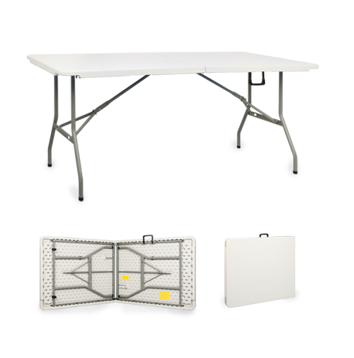
SET UP CONFIGURATION
In order to accommodate the 350 person capacity AND have an ample dance floor, there will be both round tables and rectangular tables.
Round tables will seat 8 and rectangular tables will seat 10.

Slide 6
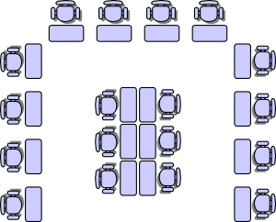
TABLE/SEAT SELECTION DATE
Tuesday, March 10, 2020
Young Middle Magnet School
Exact time periods to be decided
Table set up diagram will be available

Slide 7
TABLE/SEAT SELECTION PROCESS
Sorors WILL NOT be able to combine number of tickets sold in order to select a table.
Complete tables will be sold first.
The table selection process shall proceed as follows: First and second selections by the current chapter President and committee chairs (full tables only). All subsequent selections shall be made by all remaining sorors including officers and committee members (as per page 33 – Chapter’s Policies and Procedures - Event Seating Criteria).

Slide 8
TABLE/SEAT SELECTION PROCESS cont’d.
If a soror who purchased a ticket(s) decides to exchange or sell her ticket(s), said soror must provide Soror Paulette Walker with the exchangee’s/purchaser’s name (via email message – pwalker25p@yahoo.com), no later than Friday, March 6 at midnight in order to eliminate an embarrassing situation on Tuesday, March 10 during the table/seat selection process.

Slide 9
TABLE/SEAT SELECTION PROCESS cont’d.
If a soror who purchased a ticket(s) is unable to attend/participate in the March 10, 2020 table/seat selection process, said soror must provide Soror Paulette Walker (via email message – pwalker25p@yahoo.com), no later than Friday, March 6 at midnight with the name of the soror who will select said soror’s table/seat. Failure to do so, will result in the Committee selecting the said soror’s table/seat during the time period said soror was designated to select table/seat.

Slide 10
DONATIONS/ADS PACKAGE
If you request a donations package please see Soror Shantel Bobo or Soror Janet Solly.
If you request an ads package please see Soror Areatha Morrow.

Slide 11
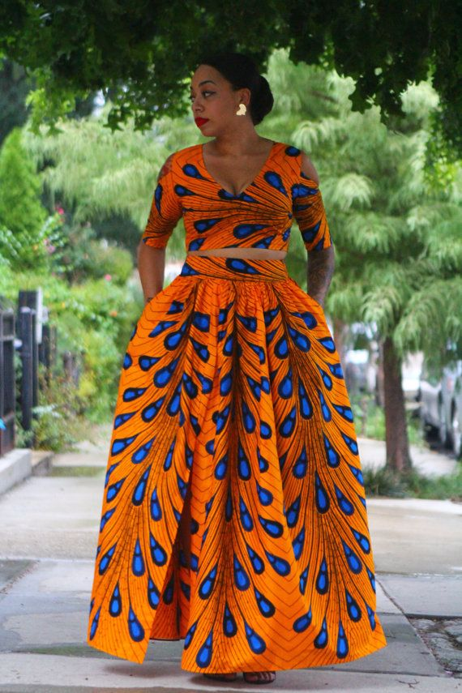
HOSTESSES
If you want to serve as a hostess on the night of the event please see Soror Marian Lauria-Gibson and remember you must have a ticket.

Slide 12
We thank you in advance for YOUR support and YOUR participation!!!

